Slide 1









My Number Interactive Notebook
$$×$$
$$\frac{1}{2}$$
$$÷$$
$$+$$
$$−$$
$$\frac{3}{5}$$
$$7$$
Name
Class
Teacher
Term 1 Semester 1
$$5^{2}$$
$$\sqrt{9}$$
1

Slide 2
Contents
Glossary or Formula Page
Page
Date
Description
2
3

Slide 3
Tasks
24
7
30
Essential Question
Questions
Notes
Summary
6
7

Slide 4
24
7
30
Date
Index Laws
EQ – Describe how the index laws can be used to simplify expressions with indices.
5

Slide 5

Task –Expand the following
$3^{4}×3^{2}$
$\frac{3^{7}}{3^{4}}$
${{(3}^{2})}^{4}$
${(4×3)}^{3}$

Slide 6
Task –Expand the following
$3^{4}×3^{2}$
$\frac{3^{7}}{3^{4}}$
${{(3}^{2})}^{4}$
${(4×3)}^{3}$
Now simplify your answers

Slide 7

Task –Expand the following
$3^{4}×3^{2}=3×3×3×3×3×3$
$\frac{3^{7}}{3^{4}}$
${{(3}^{2})}^{4}$
${(4×3)}^{3}$
Now simplify your answers

Slide 8

Task –Expand the following
$3^{4}×3^{2}=3×3×3×3×3×3=3^{6}$
$\frac{3^{7}}{3^{4}}=\frac{3×3×3×3×3×3×3}{3×3×3×3}$
${{(3}^{2})}^{4}$
${(4×3)}^{3}$
Now simplify your answers

Slide 9

Task –Expand the following
$3^{4}×3^{2}=3×3×3×3×3×3=3^{6}$
$\frac{3^{7}}{3^{4}}=\frac{3×3×3×3×3×3×3}{3×3×3×3}$
${{(3}^{2})}^{4}$
${(4×3)}^{3}$
Now simplify your answers

Slide 10
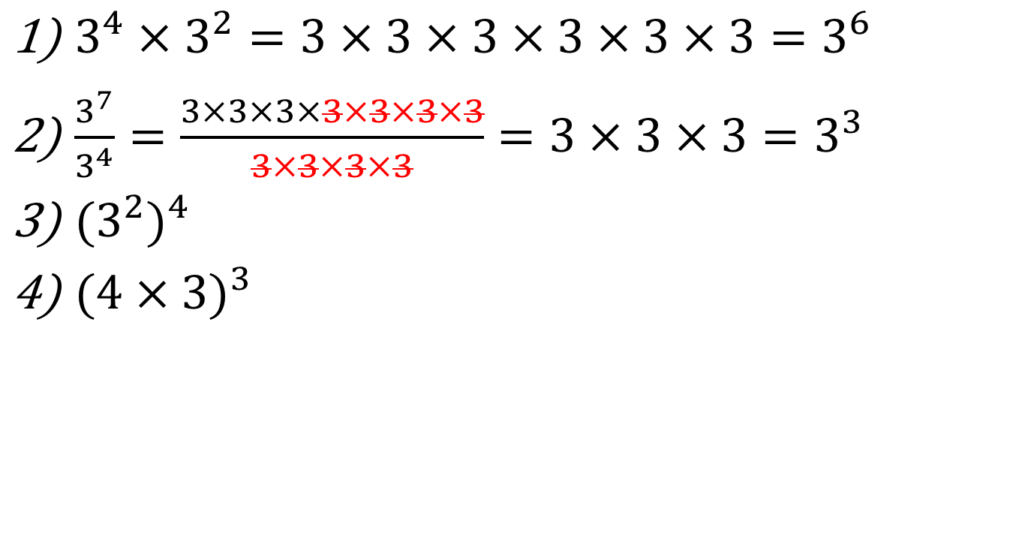
Task –Expand the following
$3^{4}×3^{2}=3×3×3×3×3×3=3^{6}$
$\frac{3^{7}}{3^{4}}=\frac{3×3×3×3×3×3×3}{3×3×3×3}=3×3×3=3^{3}$
${{(3}^{2})}^{4}$
${(4×3)}^{3}$
Now simplify your answers

Slide 11
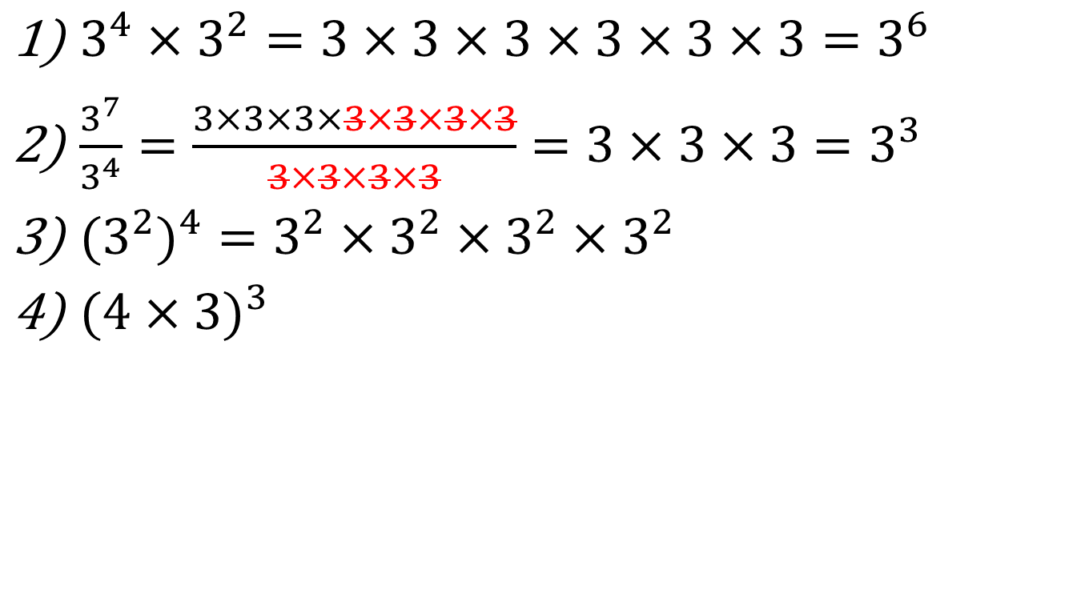
Task –Expand the following
$3^{4}×3^{2}=3×3×3×3×3×3=3^{6}$
$\frac{3^{7}}{3^{4}}=\frac{3×3×3×3×3×3×3}{3×3×3×3}=3×3×3=3^{3}$
${{(3}^{2})}^{4}=3^{2}×3^{2}×3^{2}×3^{2}$
${(4×3)}^{3}$
Now simplify your answers

Slide 12
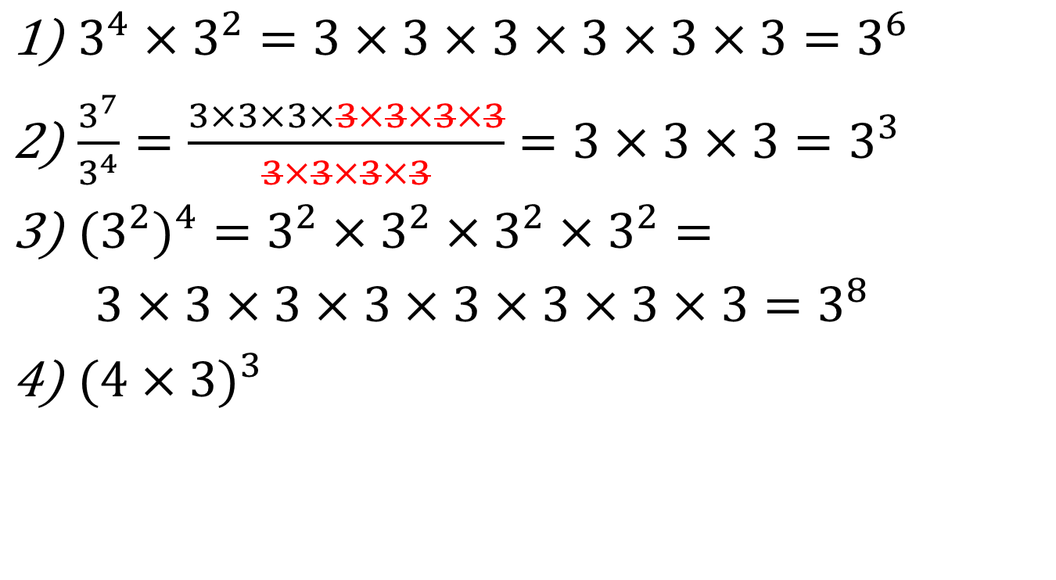
Task –Expand the following
$3^{4}×3^{2}=3×3×3×3×3×3=3^{6}$
$\frac{3^{7}}{3^{4}}=\frac{3×3×3×3×3×3×3}{3×3×3×3}=3×3×3=3^{3}$
${{(3}^{2})}^{4}=3^{2}×3^{2}×3^{2}×3^{2}=$
$3×3×3×3×3×3×3×3=3^{8}$
${(4×3)}^{3}$

Slide 13
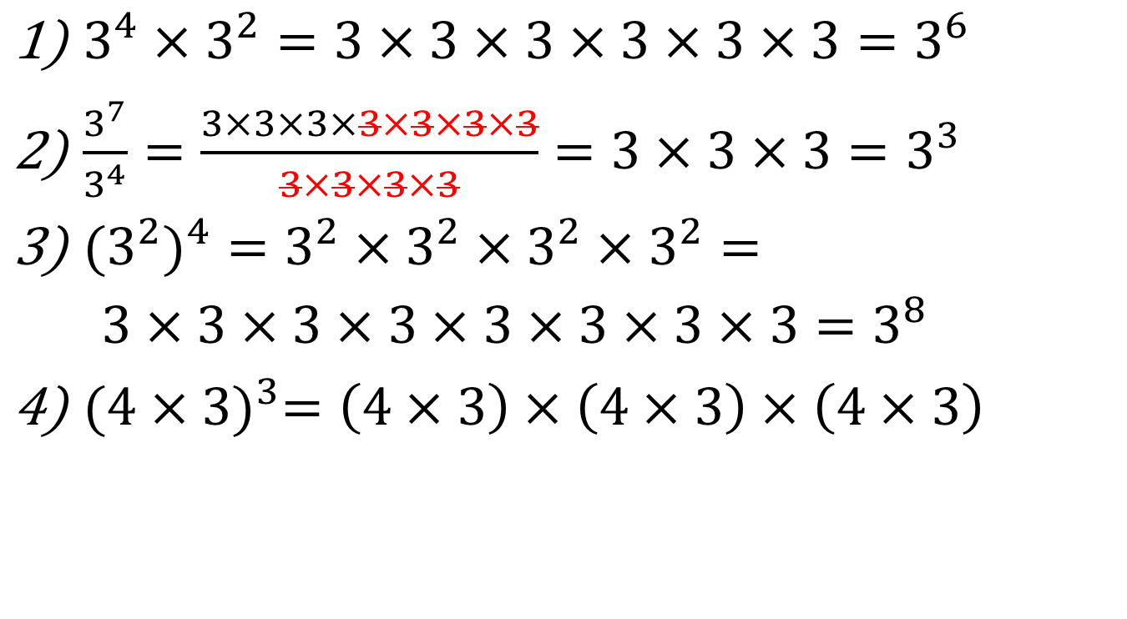
Task –Expand the following
$3^{4}×3^{2}=3×3×3×3×3×3=3^{6}$
$\frac{3^{7}}{3^{4}}=\frac{3×3×3×3×3×3×3}{3×3×3×3}=3×3×3=3^{3}$
${{(3}^{2})}^{4}=3^{2}×3^{2}×3^{2}×3^{2}=$
$3×3×3×3×3×3×3×3=3^{8}$
${(4×3)}^{3}=\left(4×3\right)×\left(4×3\right)×\left(4×3\right)$

Slide 14

Task –Expand the following
$3^{4}×3^{2}=3×3×3×3×3×3=3^{6}$
$\frac{3^{7}}{3^{4}}=\frac{3×3×3×3×3×3×3}{3×3×3×3}=3×3×3=3^{3}$
${{(3}^{2})}^{4}=3^{2}×3^{2}×3^{2}×3^{2}=$
$3×3×3×3×3×3×3×3=3^{8}$
${(4×3)}^{3}=\left(4×3\right)×\left(4×3\right)×\left(4×3\right)$
$$=4×4×4×3×3×3=4^{3}×3^{3}$$

Slide 15

24
7
30
Date
Index Laws
EQ – Describe how the index laws can be used to simplify expressions with indices.
What are the index laws?
Index Law
Example
$$a^{m}×a^{n}=a^{m+n}$$
5

Slide 16

24
7
30
Date
Index Laws
EQ – Describe how the index laws can be used to simplify expressions with indices.
What are the index laws?
Index Law
Example
$$a^{m}×a^{n}=a^{m+n}$$
$$x^{7}×x^{4}=x^{7+4}=x^{11}$$
5

Slide 17



24
7
30
Date
Index Laws
EQ – Describe how the index laws can be used to simplify expressions with indices.
What are the index laws?
Index Law
Example
$$a^{m}×a^{n}=a^{m+n}$$
$$x^{7}×x^{4}=x^{7+4}=x^{11}$$
$$a^{m}÷a^{n}=a^{m−n}$$
5

Slide 18

24
7
30
Date
Index Laws
EQ – Describe how the index laws can be used to simplify expressions with indices.
What are the index laws?
Index Law
Example
$$a^{m}×a^{n}=a^{m+n}$$
$$x^{7}×x^{4}=x^{7+4}=x^{11}$$
$$a^{m}÷a^{n}=a^{m−n}$$
$$x^{7}÷x^{4}=x^{7−4}=x^{3}$$
5

Slide 19
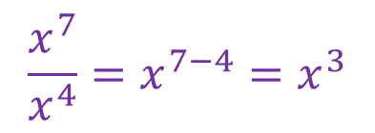

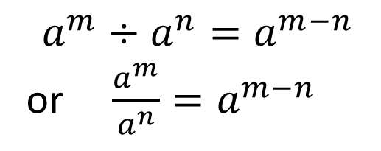
24
7
30
Date
Index Laws
EQ – Describe how the index laws can be used to simplify expressions with indices.
What are the index laws?
Index Law
Example
$$a^{m}×a^{n}=a^{m+n}$$
$$x^{7}×x^{4}=x^{7+4}=x^{11}$$
$$a^{m}÷a^{n}=a^{m−n}$$
or $\frac{a^{m}}{a^{n}}=a^{m−n}$
$$x^{7}÷x^{4}=x^{7−4}=x^{3}$$
$$\frac{x^{7}}{x^{4}}=x^{7−4}=x^{3}$$
5

Slide 20


24
7
30
Date
Index Laws
EQ – Describe how the index laws can be used to simplify expressions with indices.
What are the index laws?
Index Law
Example
$$a^{m}×a^{n}=a^{m+n}$$
$$x^{7}×x^{4}=x^{7+4}=x^{11}$$
$$a^{m}÷a^{n}=a^{m−n}$$
or $\frac{a^{m}}{a^{n}}=a^{m−n}$
$$x^{7}÷x^{4}=x^{7−4}=x^{3}$$
$$\frac{x^{7}}{x^{4}}=x^{7−4}=x^{3}$$
$$({a^{m})}^{n}=a^{mn}$$
5

Slide 21



24
7
30
Date
Index Laws
EQ – Describe how the index laws can be used to simplify expressions with indices.
What are the index laws?
Index Law
Example
$$a^{m}×a^{n}=a^{m+n}$$
$$x^{7}×x^{4}=x^{7+4}=x^{11}$$
$$a^{m}÷a^{n}=a^{m−n}$$
or $\frac{a^{m}}{a^{n}}=a^{m−n}$
$$x^{7}÷x^{4}=x^{7−4}=x^{3}$$
$$\frac{x^{7}}{x^{4}}=x^{7−4}=x^{3}$$
$$({a^{m})}^{n}=a^{mn}$$
$${(x^{7})}^{4}=x^{7×4}=x^{28}$$
5

Slide 22

24
7
30
Date
Index Laws
EQ – Describe how the index laws can be used to simplify expressions with indices.
What are the index laws?
Index Law
Example
$$a^{m}×a^{n}=a^{m+n}$$
$$x^{7}×x^{4}=x^{7+4}=x^{11}$$
$$a^{m}÷a^{n}=a^{m−n}$$
or $\frac{a^{m}}{a^{n}}=a^{m−n}$
$$x^{7}÷x^{4}=x^{7−4}=x^{3}$$
$$\frac{x^{7}}{x^{4}}=x^{7−4}=x^{3}$$
$$({a^{m})}^{n}=a^{mn}$$
$${(x^{7})}^{4}=x^{7×4}=x^{28}$$
$$({ab)}^{n}=a^{n}×b^{n}$$
5

Slide 23


24
7
30
Date
Index Laws
EQ – Describe how the index laws can be used to simplify expressions with indices.
What are the index laws?
Index Law
Example
$$a^{m}×a^{n}=a^{m+n}$$
$$x^{7}×x^{4}=x^{7+4}=x^{11}$$
$$a^{m}÷a^{n}=a^{m−n}$$
or $\frac{a^{m}}{a^{n}}=a^{m−n}$
$$x^{7}÷x^{4}=x^{7−4}=x^{3}$$
$$\frac{x^{7}}{x^{4}}=x^{7−4}=x^{3}$$
$$({a^{m})}^{n}=a^{mn}$$
$${(x^{7})}^{4}=x^{7×4}=x^{28}$$
$$({ab)}^{n}=a^{n}×b^{n}$$
$${(6×3)}^{4}=6^{4}×3^{4}$$
5

Slide 24
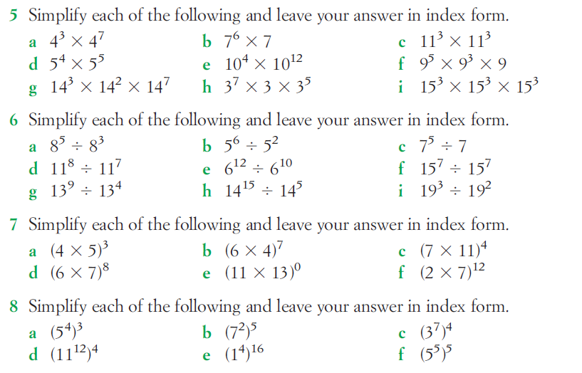
Questions

Slide 25
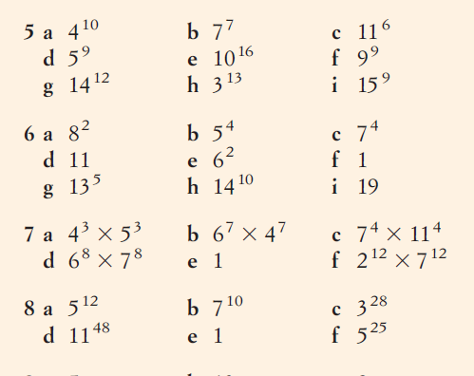
Answers

Slide 26
Notes Review
24, 7 ,30
Date
Title
Essential question
Notes complete
Notes complete with colour and diagrams
Questions completed
Contents page filed in
Formula page filled in

Slide 27
Homework
Review your notes and write a summary answering the essential question.

